Slide 1
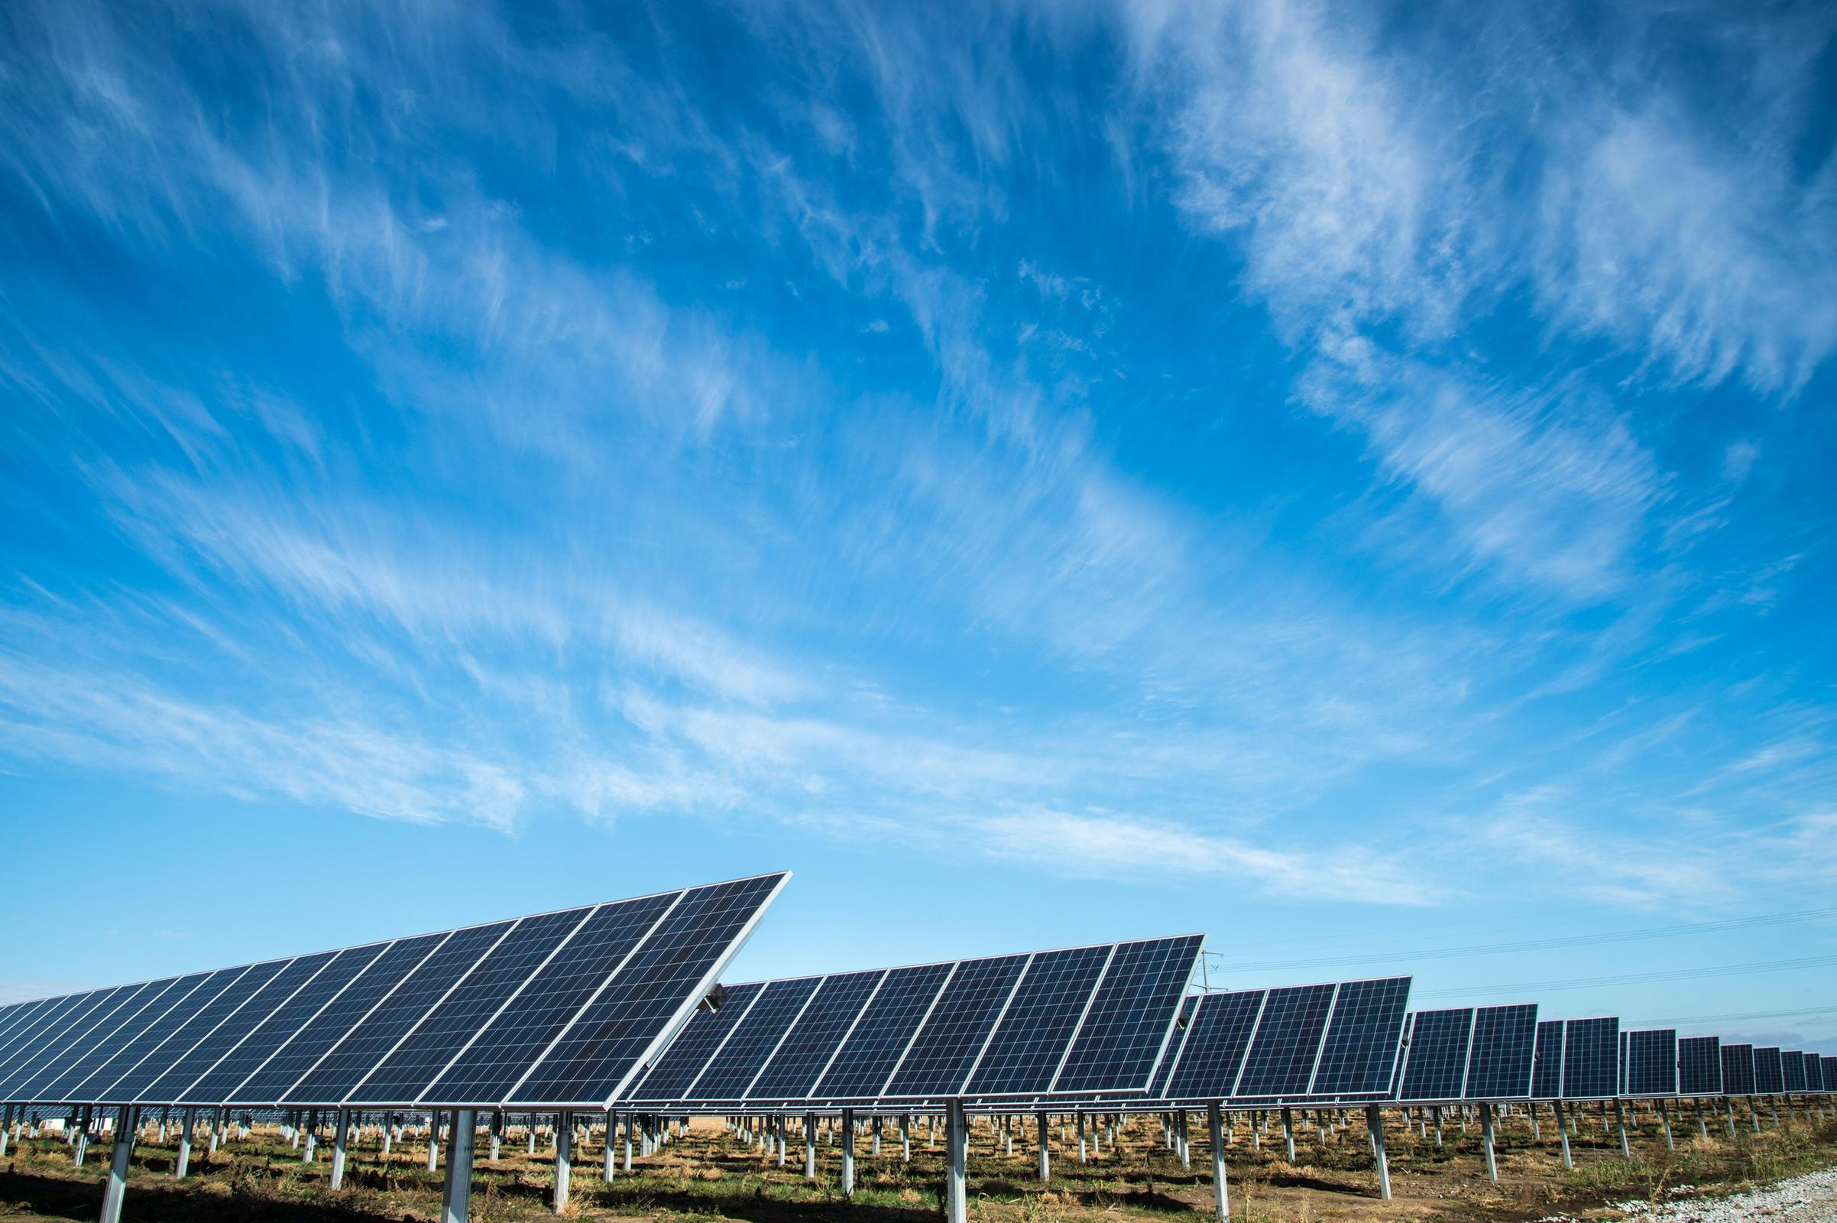
Team Zero
Amin Mansouri
Jefry el Bhwash
Levy Duivenvoorden
Niels van Drunen
Niels van Schaik

Slide 2
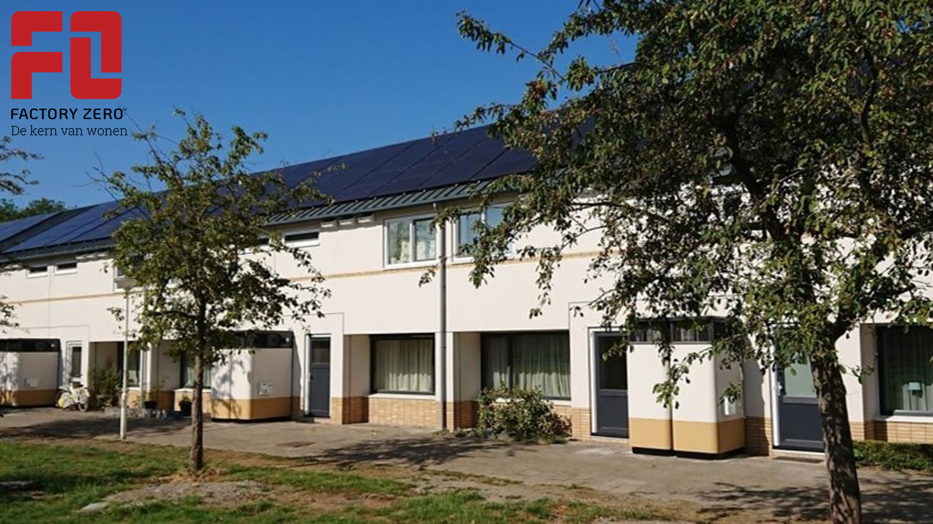
Their Goal:
To make the energy transition possible for everybody, making way for a renewable and energy efficiënt living environment.

Slide 3
Research Question
What is a suitable machine learning model to predict energy use and production of a “zero at the meter” house, one day in advance with hourly resolution?
And perhaps…
When to store or sell the produced solar energy to maximise the profit of the user?

Slide 4
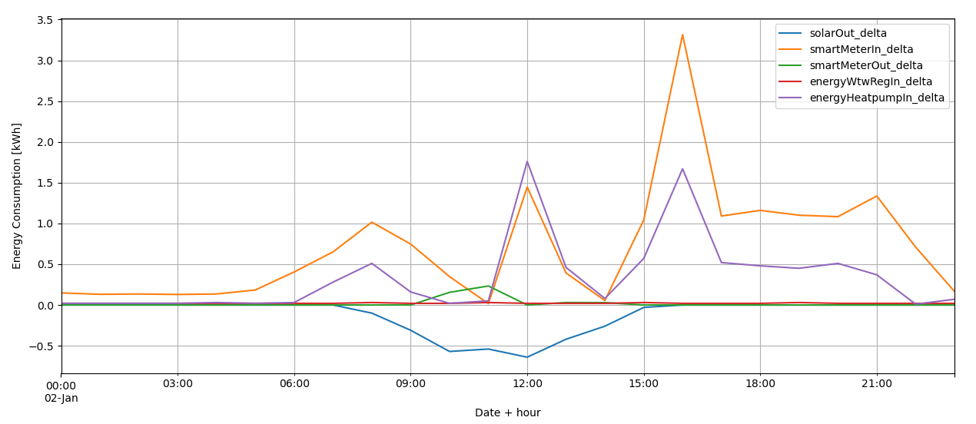
Progress
Energy consumption of house 001 on 2019-01-02
Data normalised & resampled per hour
Weather data

Slide 5
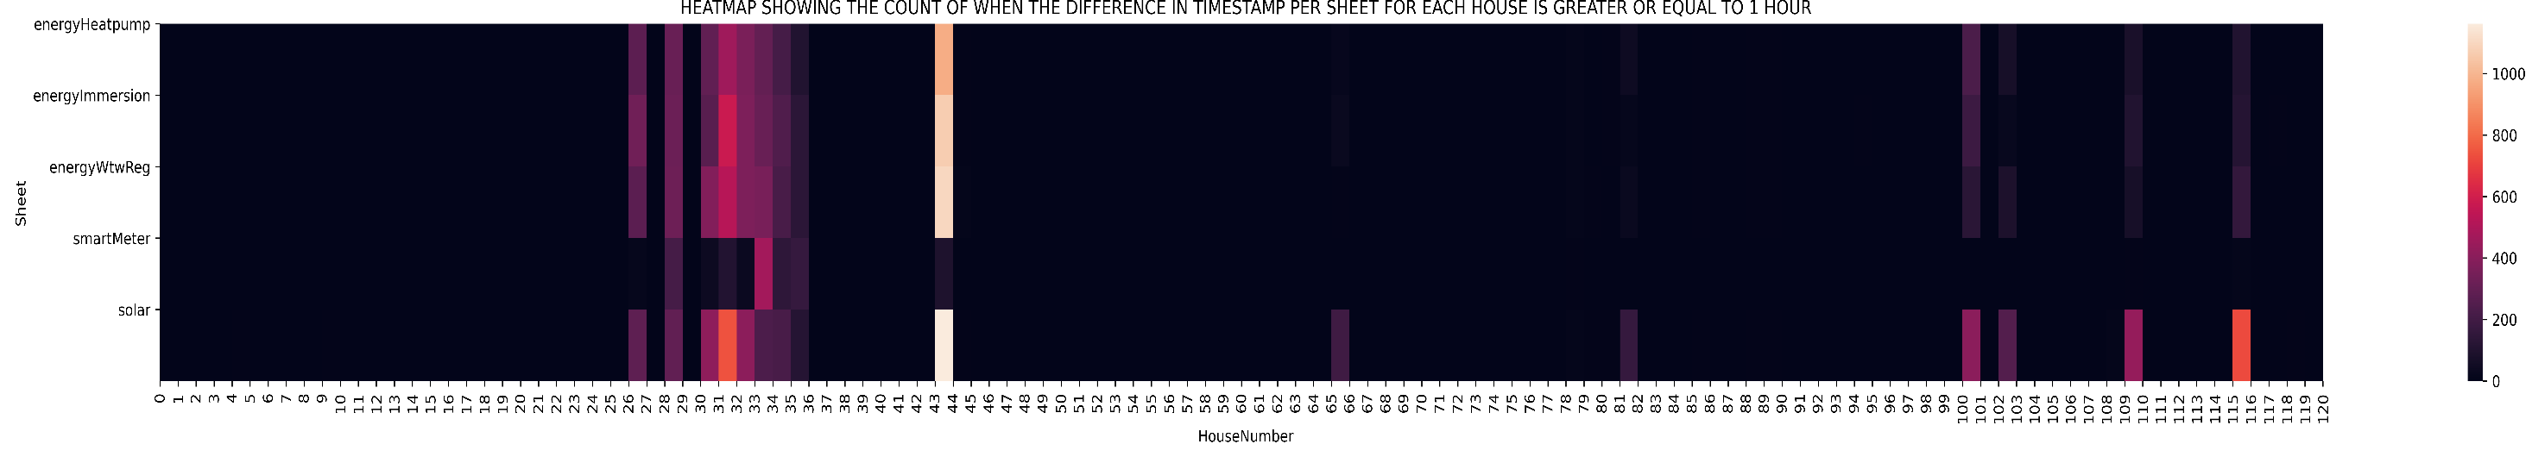
Progress
Data Quality (heatmap)
Regression on the solar energy produced

Slide 6
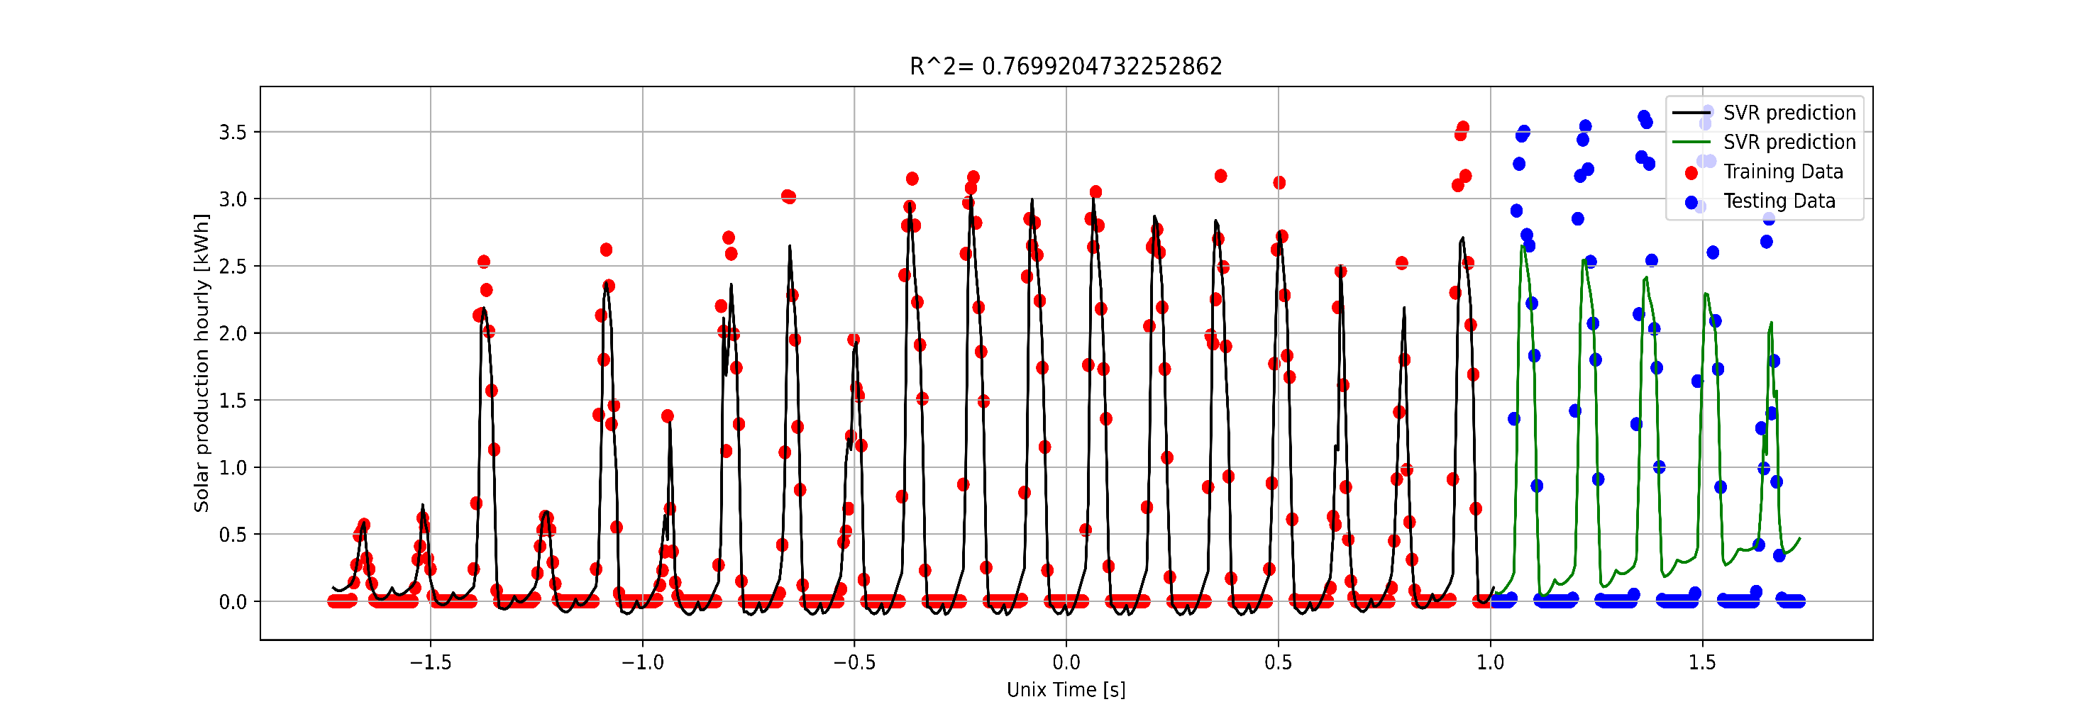
A simple forecasting model
The model is a SVR (Support Vector Regression)
SVR analyses the data and chooses which of the datapoints are most important to use in the regression, therefore greatly reducing the potential outliers have on the regression.

Slide 7
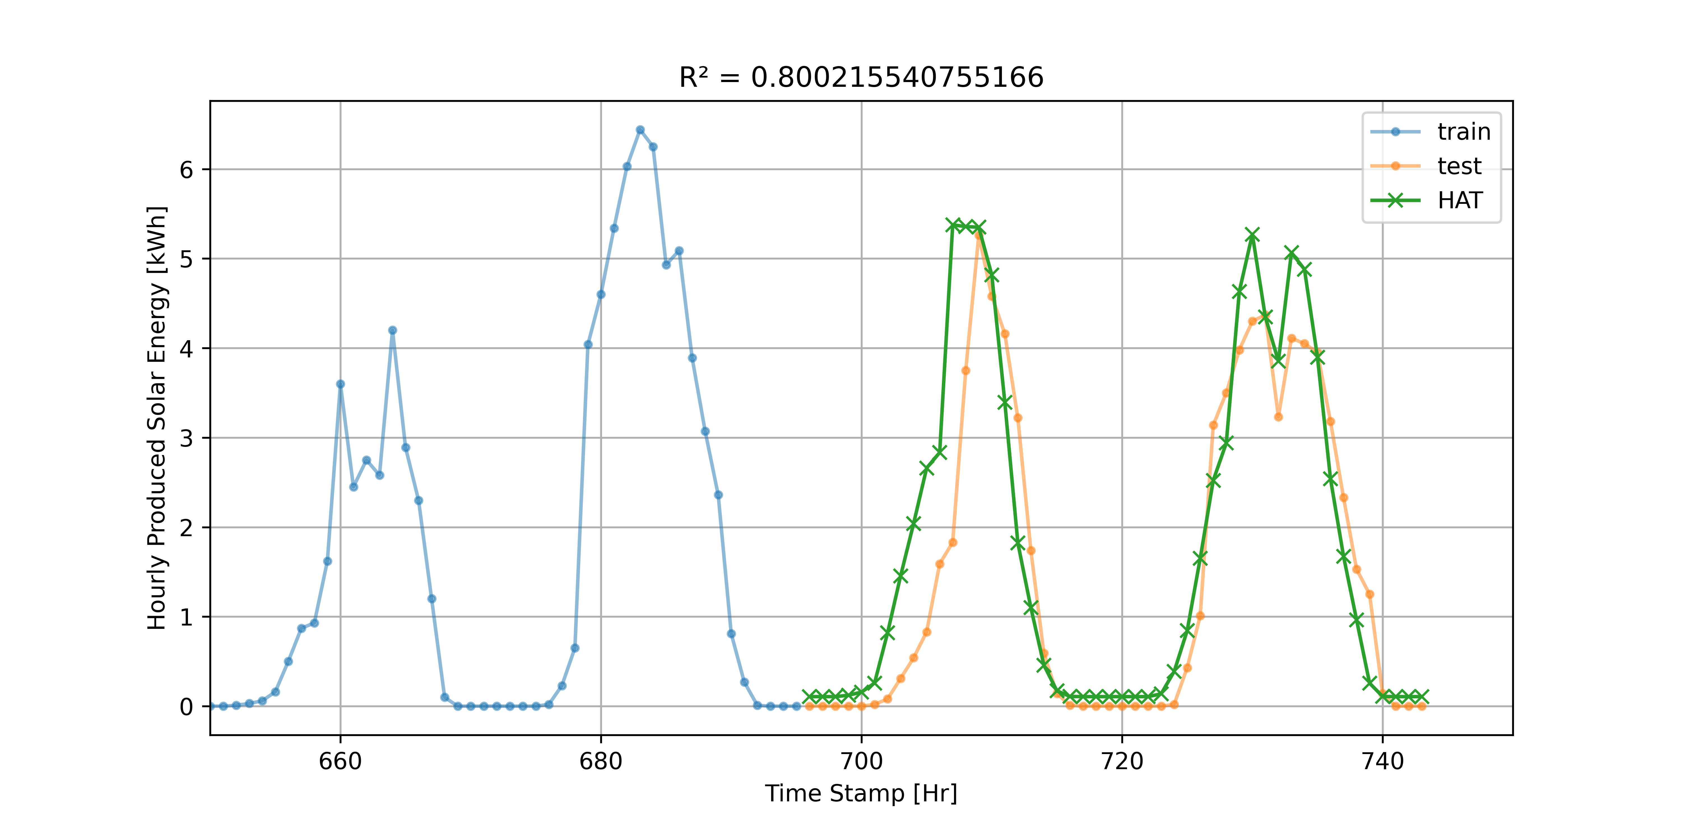
A simple forecasting model
The model is a MVLR (Multi Variate Linear Regression)
MVLR can create a mathematical regression based on multiple input variables, thus making a regression in multiple dimensions.

Slide 8
Future
Weather predictions
SVR (regression model) to keep as a baseline check (10 day interval)
LSTM (neural network)
Start working with energy consumption
Make a heatmap that focusses on the calmer parts of the data

Slide 9

Remarks, Suggestions, Questions

